Slide 1
Natural Language Processing
(NLP)
Presenter: YoutengLiang (梁有騰)
Notes:
Good afternoon, welcome the the big data analytics course, I am the TA {name}.
In these three hours, we are going to guide you through the NLP model building.

Slide 2
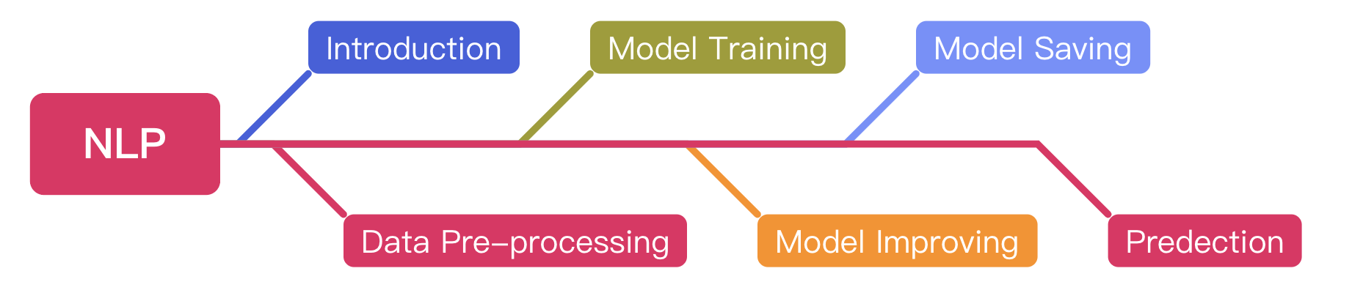
Agenda
Notes:
That is the agenda, in these sections.
Chapter 1 is the introduction, we will briefly introduce the concept of ML, DL, and NLP as well.
And the following 5 chapters are the process of building a DL model, we will guide you guys to build a model step by step.
First is the data pre-processing, since the data might be dirty, we should do simple pre-processing for training convenience.
Next is the model training, we will show you how to declare and train a DL model.
Third is the model improvement, you know, nothing will be perfect the first time, our model either, but don’t worry we will introduce five different improvement methods in this chapter.
After we train and improve our model, of course, we should know how to do the model saving.
Finally, we can try to evaluate these models.

Slide 3
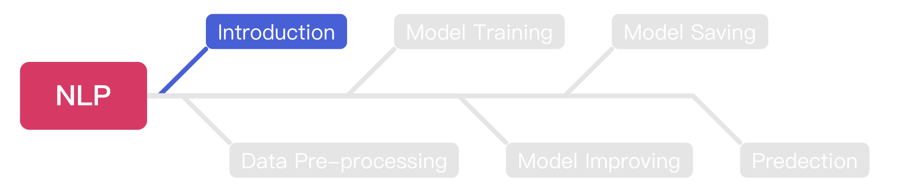
Agenda
Notes:
The first section is Introduction, the basics of ML & DL will be introduced in this section.

Slide 4
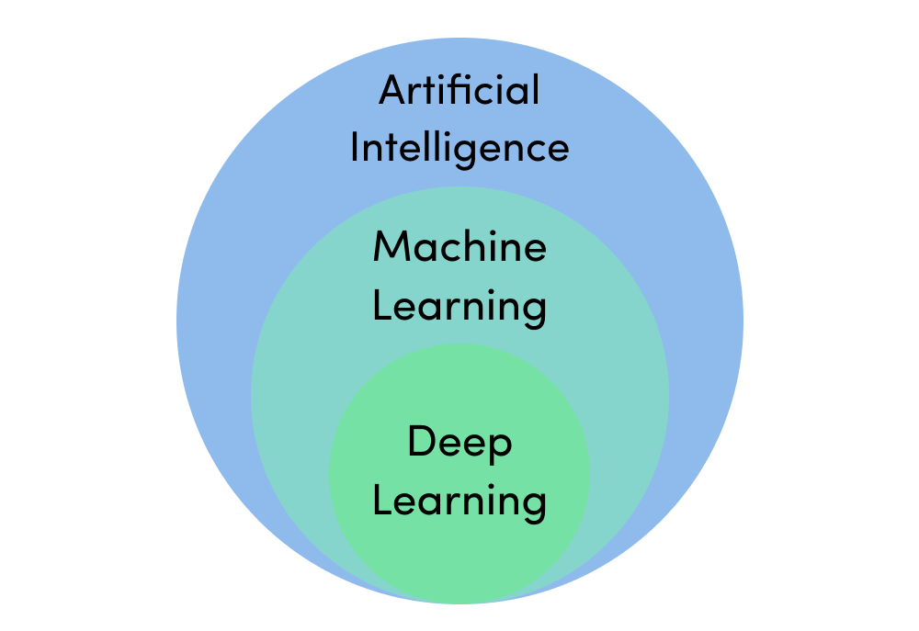
Machine Learning & Deep Learning
https://assets.website-files.com/5fb24a974499e90dae242d98/5fb24a974499e96f7b2431db_AI%20venn%20diagram.png
Notes:
Talk to ML, we always connect ML with AI.
In fact, ML is a sub-field of AI, Ai means the systems or machines that can imitate human intelligence to complete tasks.
ML is an algorithm to achieve that goal.
And Dl is also a sub-field of ML, which has a deeper NN than ML.

Slide 5
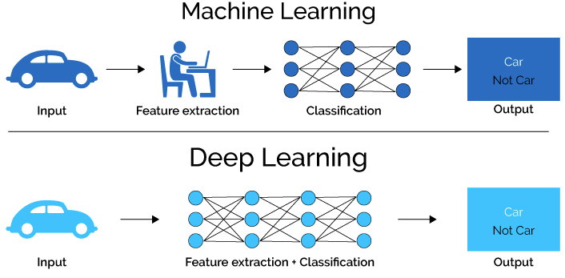
Machine Learning & Deep Learning (Cont’d)
https://medium.com/ai-academy-taiwan/%E7%82%BA%E4%BB%80%E9%BA%BC%E6%A8%A1%E5%9E%8B%E6%9C%83%E9%80%99%E6%A8%A3%E8%AA%8D%E7%82%BA-%E8%A7%A3%E9%87%8B%E7%9A%84%E6%B7%B1%E5%BA%A6%E5%AD%B8%E7%BF%92%E6%96%B9%E6%B3%95%E7%9A%84%E4%BB%8B%E7%B4%B9-%E8%A6%96%E8%A6%BA%E5%8C%96%E7%AF%87-1ac69c627483
Notes:
The major difference between ML and DL is the neural network depth.
For ML, the feature extraction will be done by researchers, for instance, researchers will tell the model like: a car should have four wheels, four windows, etc.
But for DL, these extractions should be done by the NN itself, so that a DL model will have a deeper NN than an ML model.

Slide 6

Deep Learning Model
https://towardsdatascience.com/converting-a-simple-deep-learning-model-from-pytorch-to-tensorflow-b6b353351f5d
Notes:
Typically, a DL model consists of one input layer, several hidden layers, and one output layer.
The neural number of the input layer should be the same as the data dimension, for instance, a 1 * 16 vector should work with the input layer that has 16 neural.
And more hidden layers might improve the accuracy, but the training time will also get higher.
And the neural number of the output layer should be determined according to the activation functions.

Slide 7
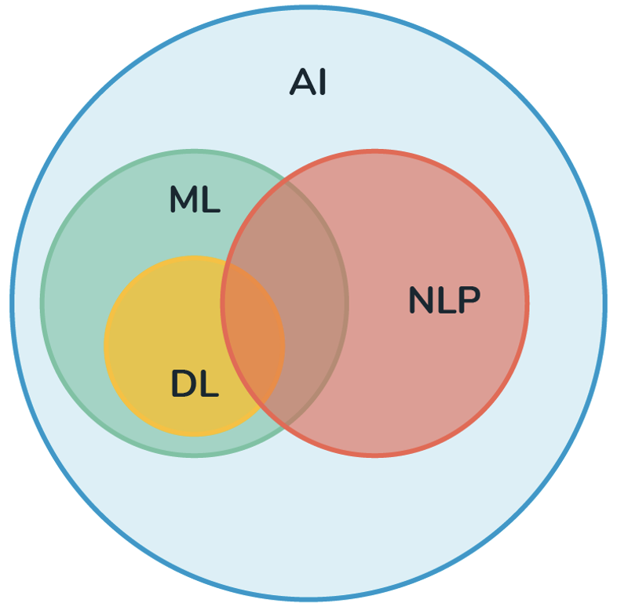
NLP
NLP is stands for Natural Language Processing.
NLP is a subfield of AI.
The main idea of NLP is to make computers understand the human language ex. English or Mandarin.
https://medium.com/@derekliao_62575/%E8%87%AA%E7%84%B6%E8%AA%9E%E8%A8%80%E8%99%95%E7%90%86-nlp-%E5%88%B0%E5%BA%95%E6%98%AF%E4%BB%80%E9%BA%BC-e29ab6356f6d
Notes:
Then, it’s our topic, what is NLP? Does anyone hear about that before? (If yes, let them explain it.)
NLP stands for Natural Language Processing, the key idea is to make our computer understand what we are talking about.
Nature Languages stands for human languages, such as English, Mandarin, Japanese, etc.
Voice assistants such as Google Assistant, Siri, and Alexa, are able to understand what we are talking about and then give us the corresponding reactions,
after this course, perhaps you can try to build your own voice assistant. That will be fascinating.

Slide 8
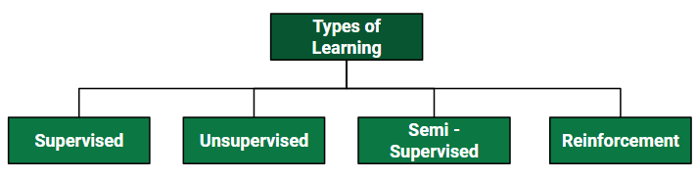
Supervised Learning
Supervised learning is one of the machine learning methods.
A set of question-answer pairs will be provided for training.
The model will try to figure out the connection between each question and the corresponding answer.
After training, this model can answer questions that have never been seen before.
https://www.geeksforgeeks.org/ml-types-learning-supervised-learning/
Notes:
Then, how do we make our computer understand NL?
The simplest method is to use supervised learning.
During training, a set of question-answer pairs will be provided to a DL model, then this model will try to learn the connection between each question and answer.
After training, this model is expected to answer questions it has never seen before as well.

Slide 9
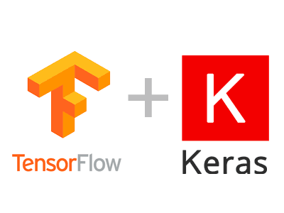
TensorFlow vs. Keras
TensorFlow is a machine learning model build by C++, it can help user to train a machine learning model.
Keras is a package that can help users to invoke TensorFlow easier.
The functions Keras provided can help user to create and train a NN model easier.
https://dsalearning.github.io/tf.keras/2-2-tf-keras-python-dl-env/
Notes:
So, how do we do the learning, perhaps you heard about Tenser flow, or Keras, these two are machine learning models, but which one is the easiest choice?
Let me give you an answer, if you did not have any experience with ML, try Keras, it is easier to use, easier to learn, and easier to code.
But if you want to improve the accuracy or you want to tune your model from a more professional perspective, use Tensor flow, it can make your model better.

Slide 10

Google Colab
Before we start coding, we should know how to use google colab.
Google colab makes you able to write & run python code online.
The most important is Google colab provides free GPU resource for machine learning model training.
https://clay-atlas.com/blog/2019/09/29/colab-chinese-tutorial/
Notes:
It has a high hardware requirement for training a DL model, luckily, Google colab provides free online GPU & RAM resources for model training.
Despite you don’t have a model training requirement, Google colab can also be used for python project building as well.

Slide 11
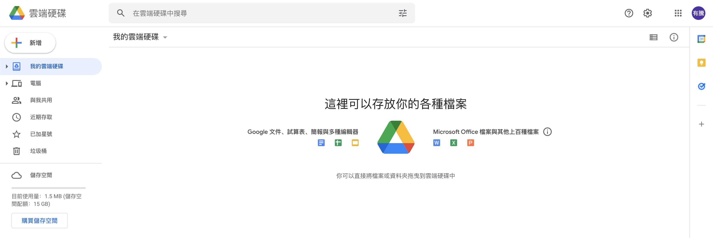
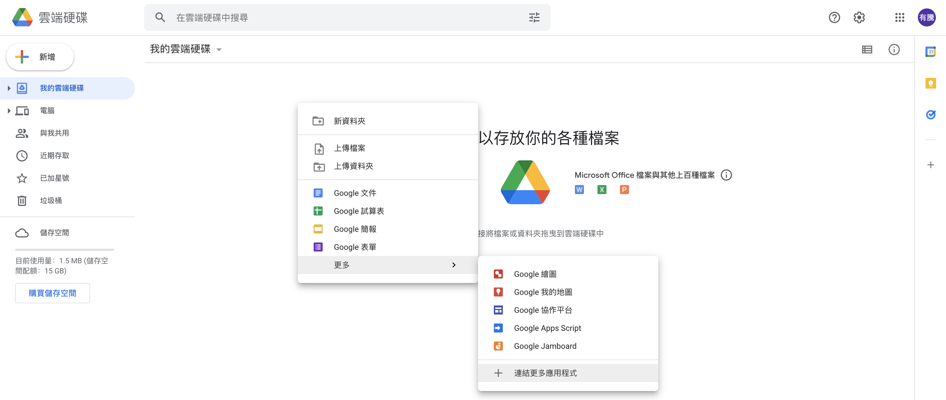
Connect Colab into Google Drive
We should connect colab into google drive before we use it.
Right Click
Notes:
You can right-click in any blank space on google drive, then press ”connect more applications.”

Slide 12
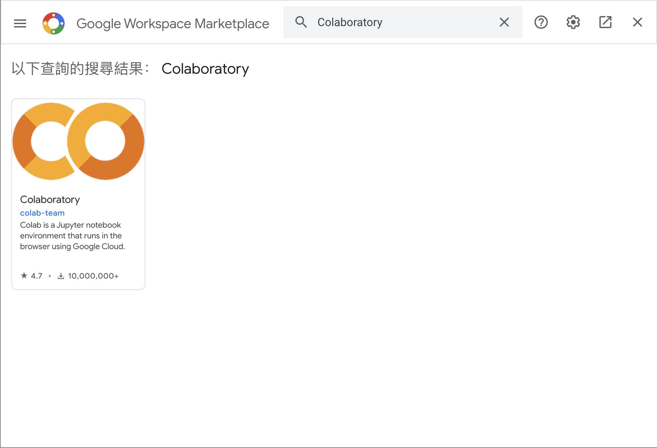
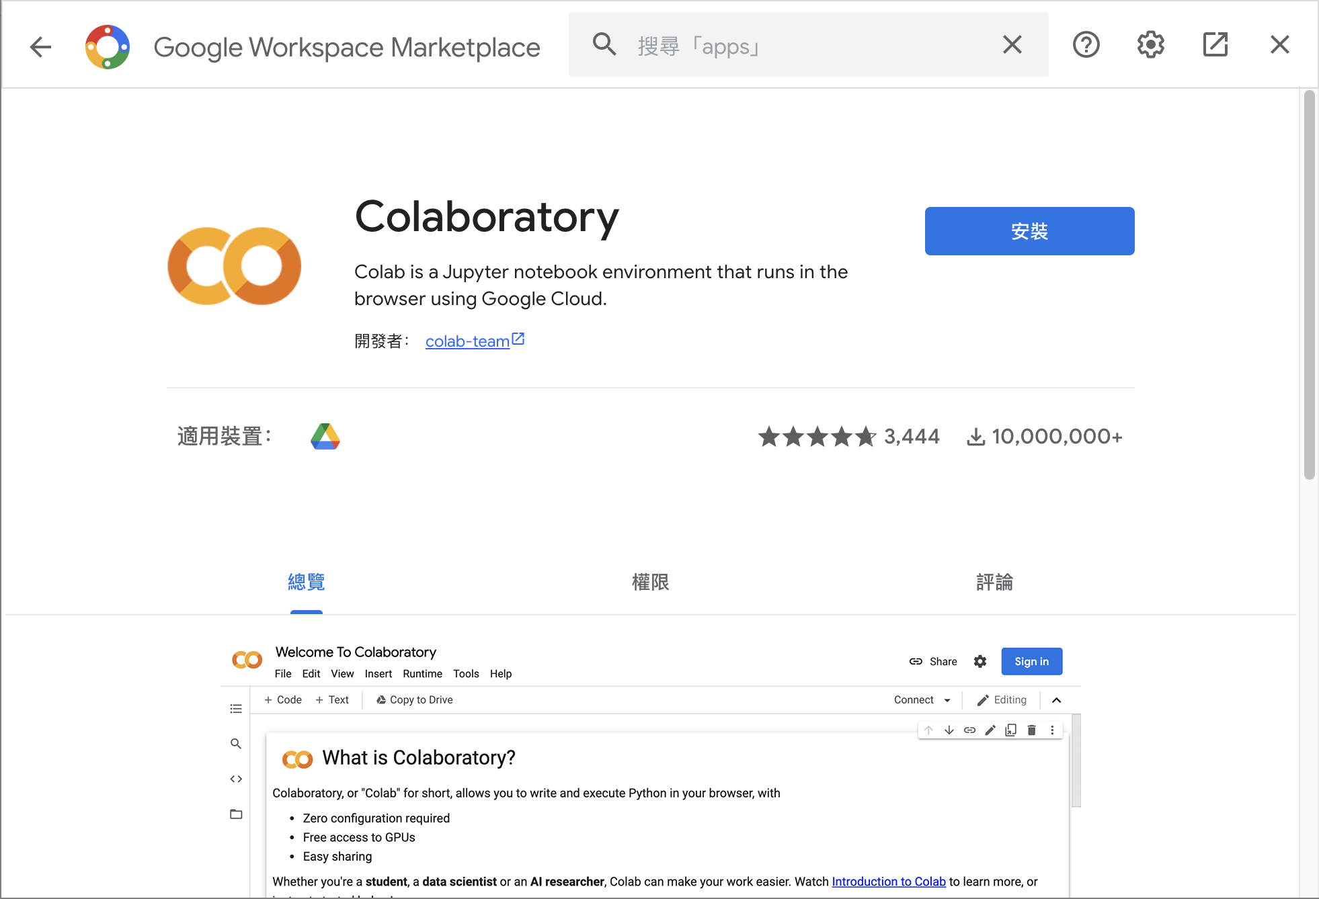
Connect Colab into Google Drive (Cont’d )
Search colab and install it.
Notes:
Then search Collaboratory on the marketplace.

Slide 13
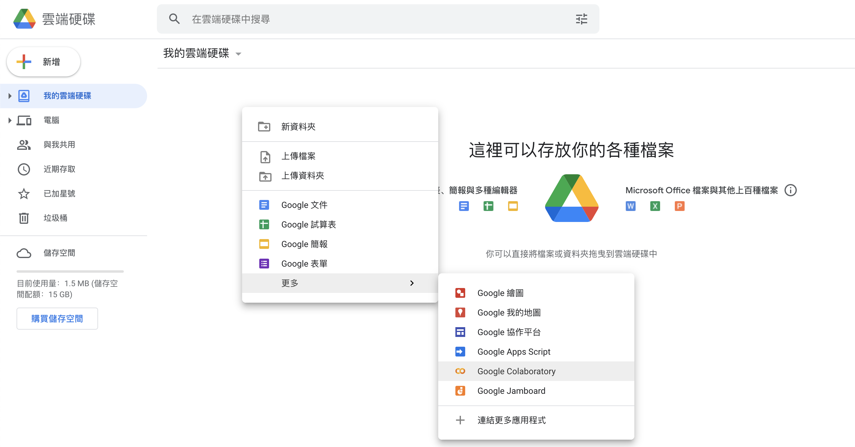
Connect Colab into Google Drive (Cont’d )
After installed, you can create a new colab notebook.
Notes:
Once connected, you can add a new colab notebook on google drive.

Slide 14
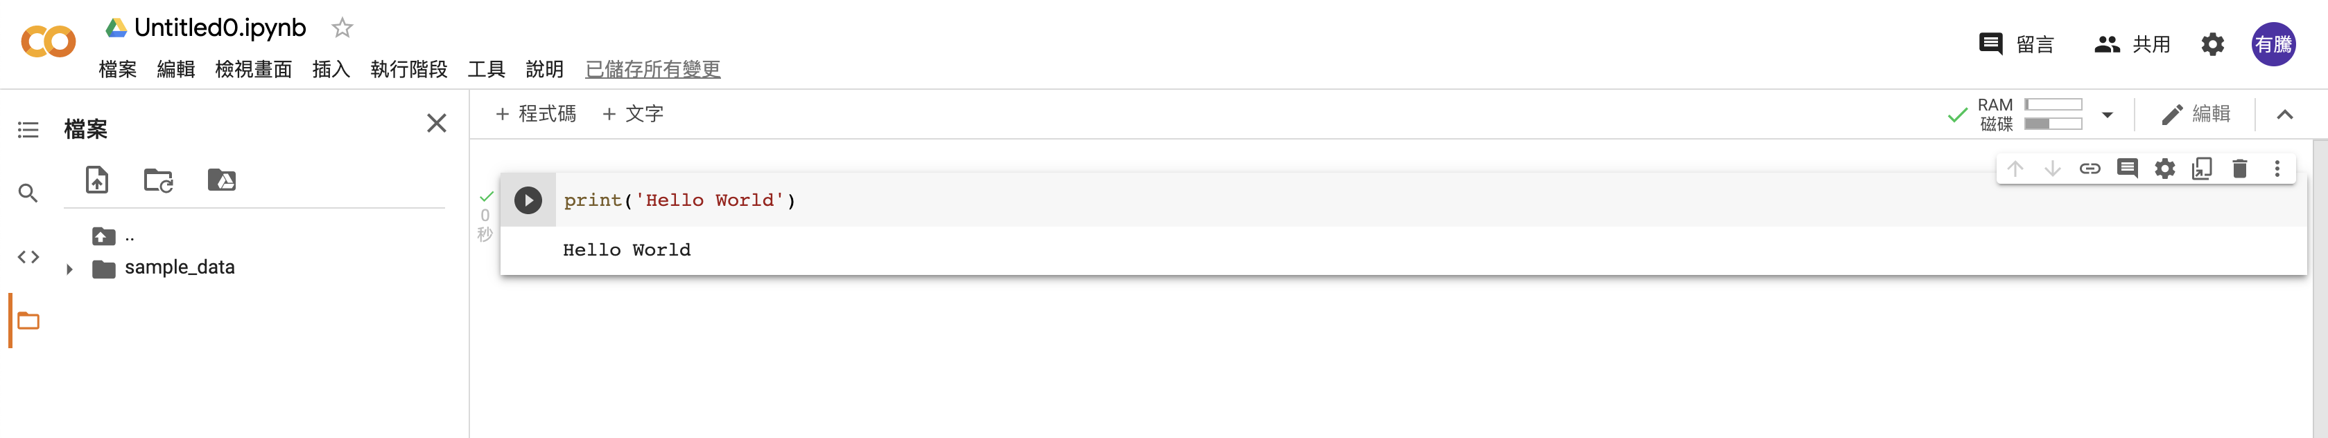
Colab UI
Notebook Name
Code Cell
Python Code
Output
Files
Execute Button

Slide 15
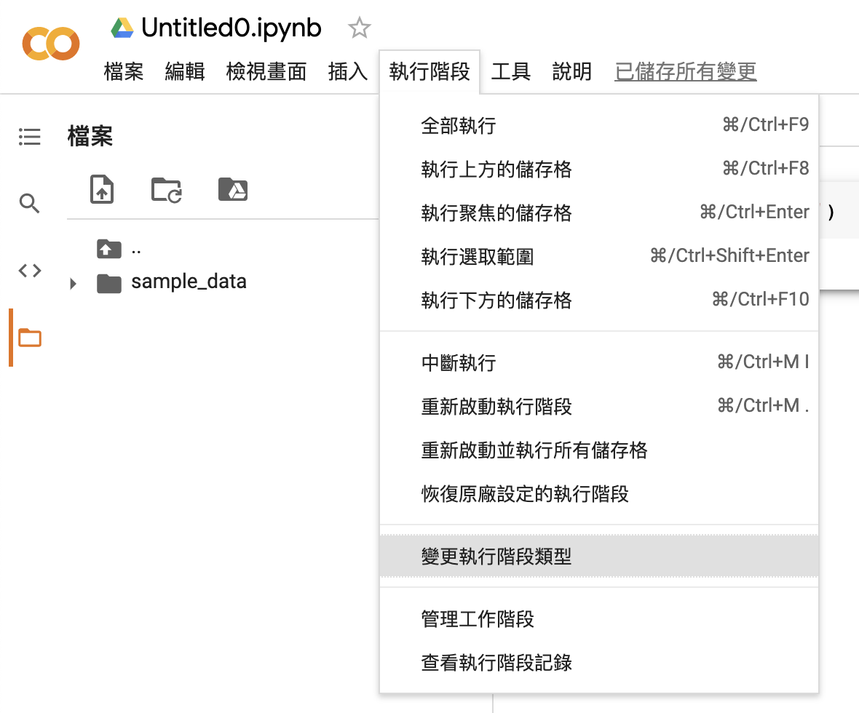
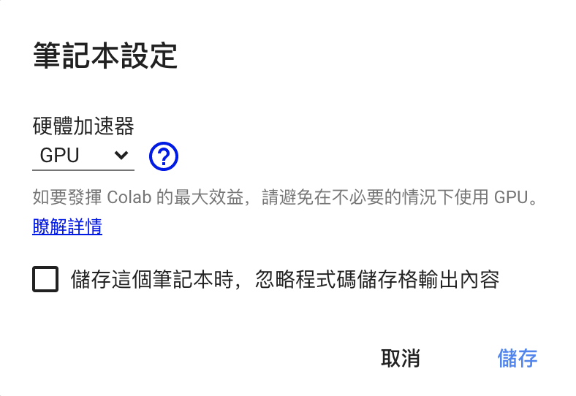
Change to Use GPU
We can change to GPU hardware accelerator.
Notes:
Please note that we should change the hardware accelerator to GPU for training efficiency.

Slide 16
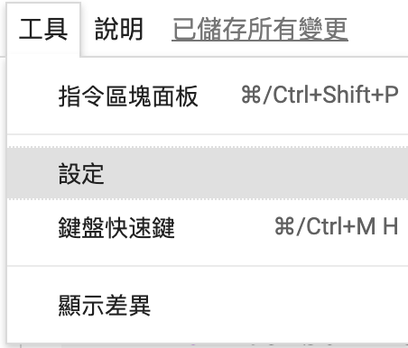
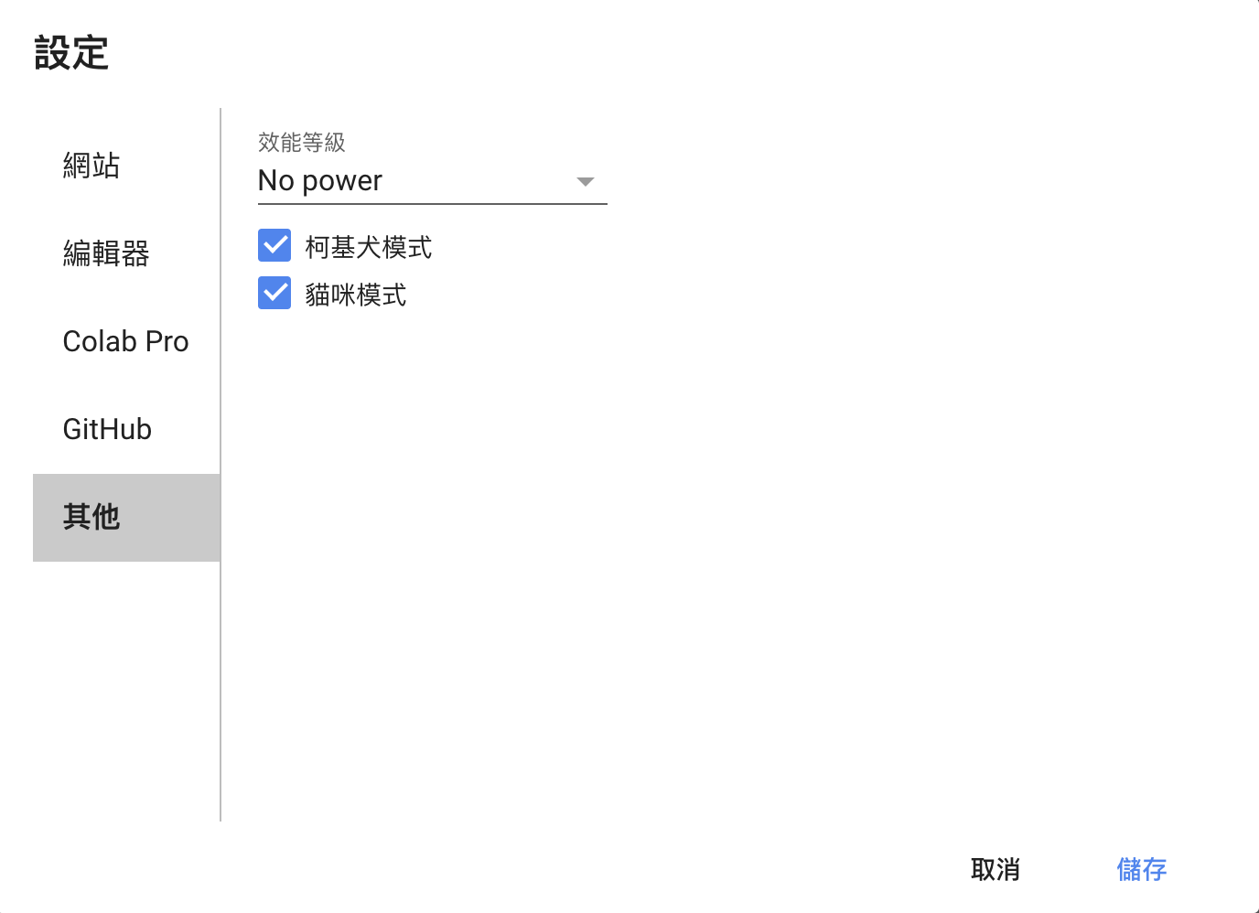
Open Cats and Corgis Mode
Please follow the steps to open cats and corgis mode, which can please you during coding works.
Notes:
Open it!!!!!!

Slide 17
Open Cats and Corgis Mode (Cont’d)
Once opened, you can see there are cats and corgis on your screen.
That’s the most important function of Google colab, absolutely.
Notes:
Cute!!!!!

Slide 18
Tensor Flow Dataset (TFDS)
TFDS is a python model that can help use to get datasets.
Install TFDS with pip.
!pip install tensorflow-datasets
Notes:
We know we should have a bunch of data to train if we want our model better, but how, do you think you will collect all the data for training every time? Of course not, there’re lots of dataset providers on the internet, TensorFlow is one of them, TFDS can help us to get these data set.
TFDS is one of the python packages, it stands for TensorFlow Data Set, you can use the pip command to download this package in the terminal, now please download it, I will give you three minutes to do that.
After installation, please open Colab and type this python code “tfds.load(‘fashion_mnist’)”, it will load this dataset from the TF server.

Slide 19
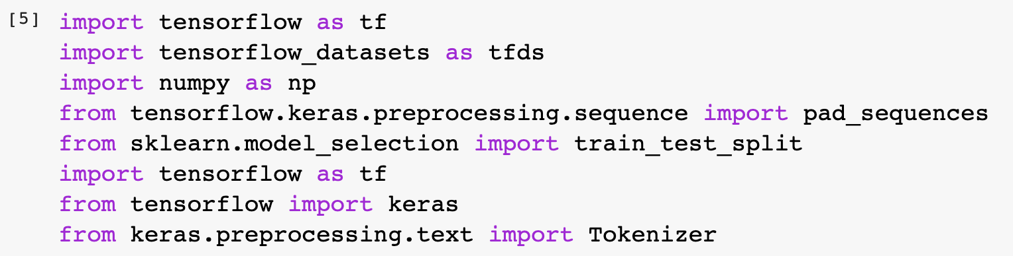
Import Packages
Notes:
import tensorflow as tf
import tensorflow_datasets as tfds
import numpy as np
from tensorflow.keras.preprocessing.sequence import pad_sequences
from sklearn.model_selection import train_test_split
import tensorflow as tf
from tensorflow import keras
from keras.preprocessing.text import Tokenizer

Slide 20
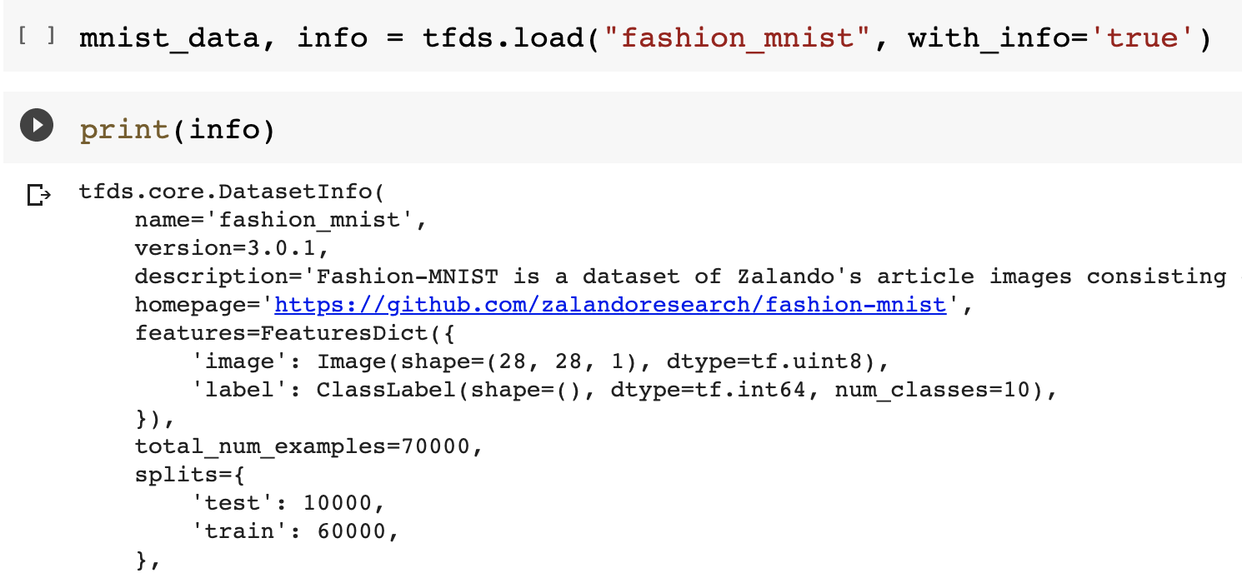
TFDS (Cont’d)
Notes:
The fashion_mnist data set can be loaded with TFDS.
The detailed information can be printed after loading.

Slide 21

Sarcasm Detection
We are going to build a sarcasm detection model.
This model can help us to classify the sentence sarcasm or not.
We will complete this experiment with Keras.
https://www.wyo.in/pub/media/mf_webp/png/media/catalog/tmp/category/Sarcasm.webp

Slide 22
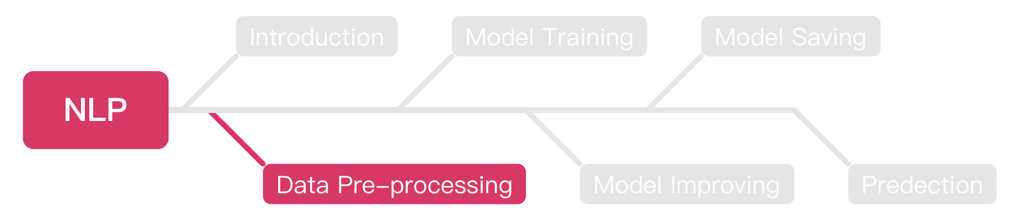
Outline

Slide 23
Tokenization
We can replace the words with numbers in a sentence.
“I love dog” = [1, 2, 5]
“I love cat” = [1, 2, 3]
“I love a cat” = [1, 2, 4, 3]
Notes:
Before we started to train our model, all the sentences should be changed to index lists.

Slide 24
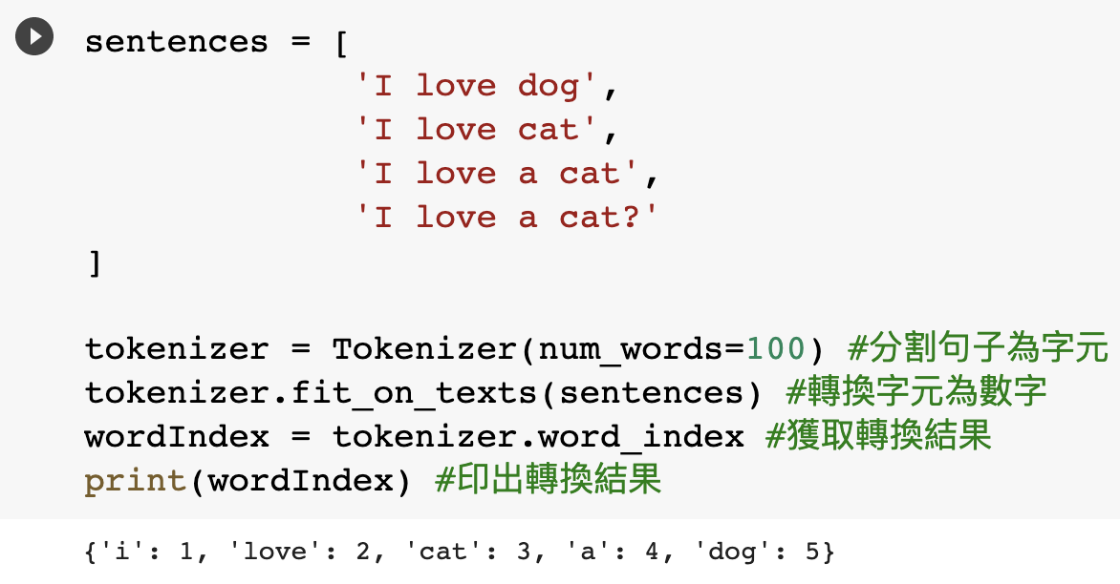
Tokenization (Cont’d)
We can use python package to do the tokenization easily.
Notes:
The tokenizer is a python package that can help us to transfer words to indexes.

Slide 25
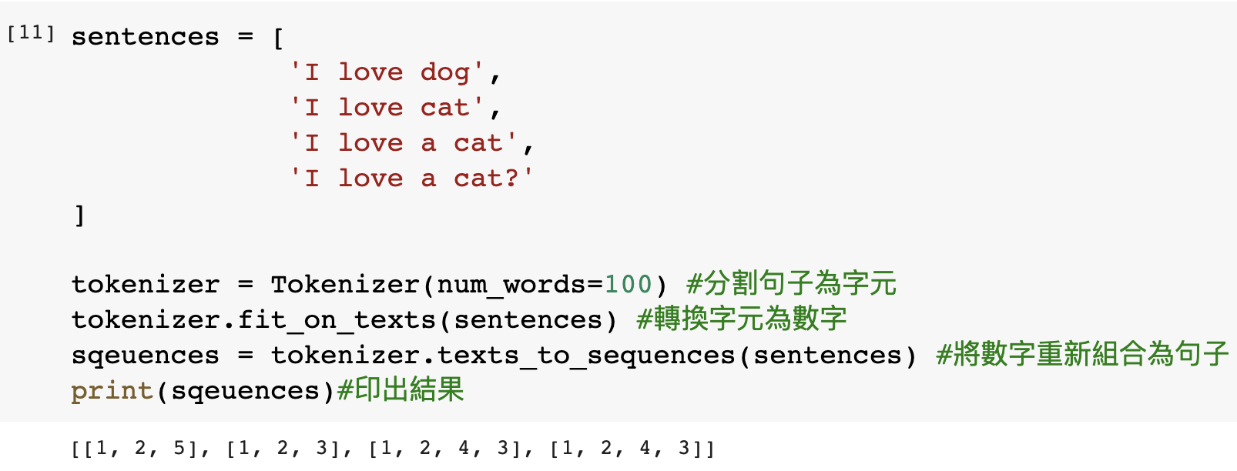
Texts to Sequences
We should combine the indexes with the sentences.
Notes:
Then we should combine the indexes with the sentences.

Slide 26
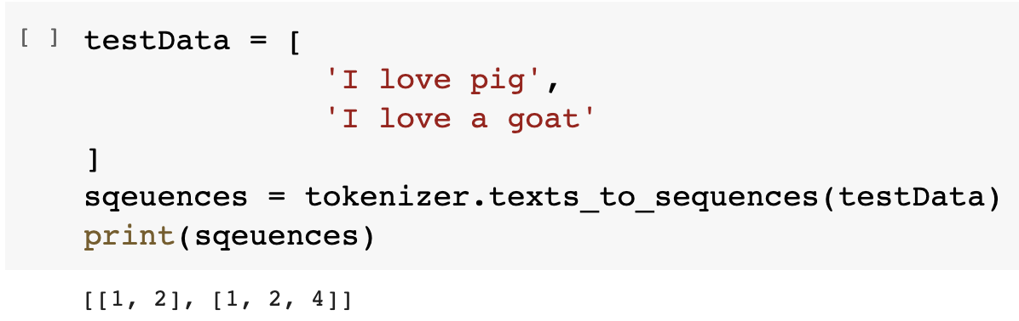
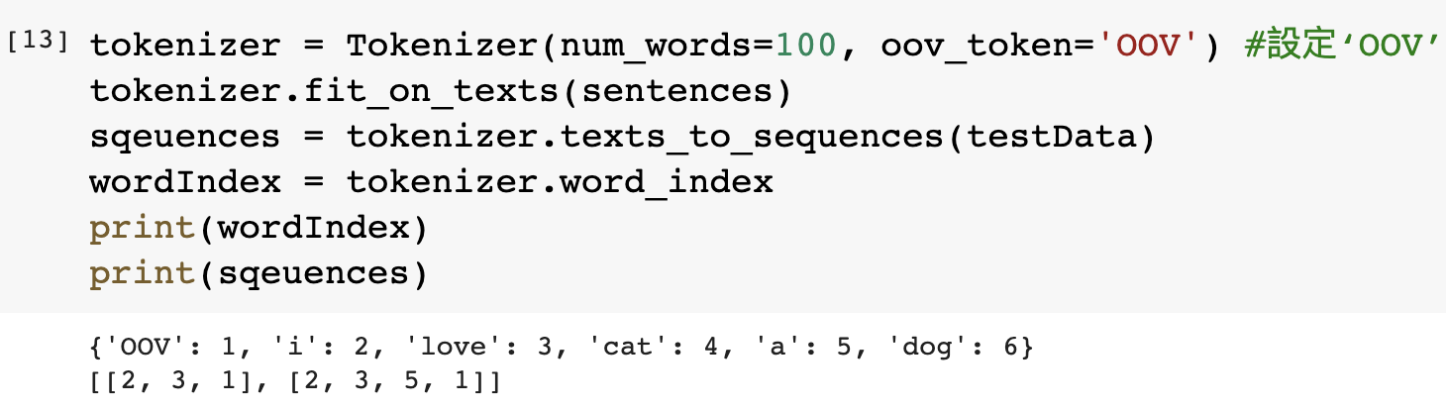
Out of Vocabulary (OOV)
OOV means your algorithm can’t understand the word, it means this word doesn’t exist in the vocabulary.

Slide 27
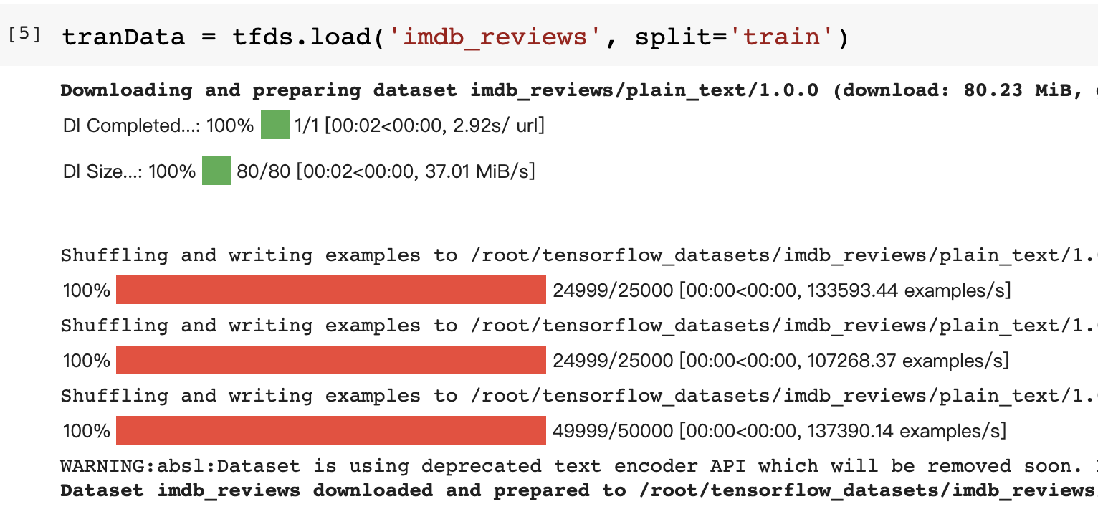
Get Texts from TensorFlow
We can get the texts from TensorFlow.
Notes:
We can download the text from TensorFlow to avoid OOVs.

Slide 28
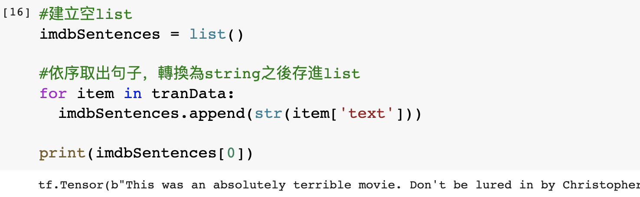
Get Texts from TensorFlow (Cont’d)
After loaded, we can append each sentence into a list.
We can try to print the first data.

Slide 29
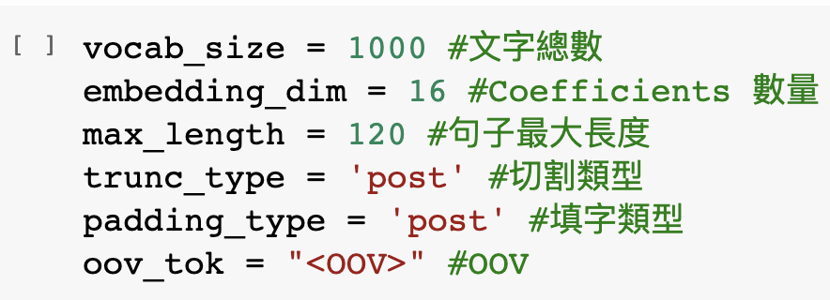
Parameters Declaration
These parameters will be use during our model train part, you can try to set it to different value and observe the differences.

Slide 30
Sarcasm Dataset
From now on, we will start to build a model for sarcasm detection.
We should do data pre-processing before to build a ML model.
Basically, the datasets will be provided in .json or .csv file format.
The format of example dataset is .json, but practice data set will be .csv, please try to practice how to load these two different file format.

Slide 31
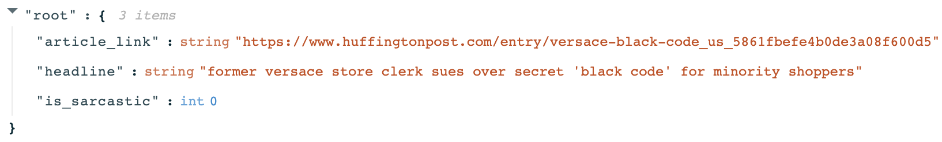
Sarcasm Dataset (Cont’d)
The following is the format of the sarcasm dataset as .json file, you should load and categorize all data as well.

Slide 32
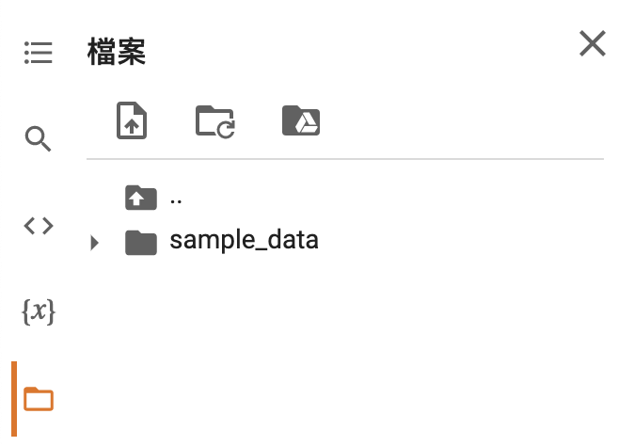
Upload File to Colab

Slide 33
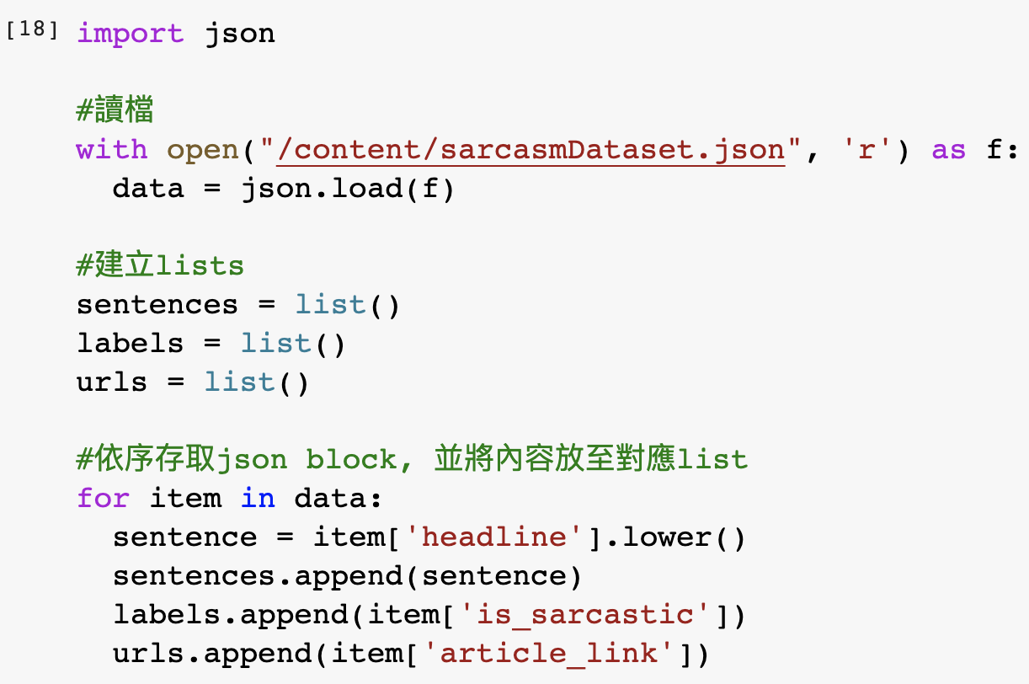
Load Data from Json File
The following is the process of loading dataset form .json file.

Slide 34
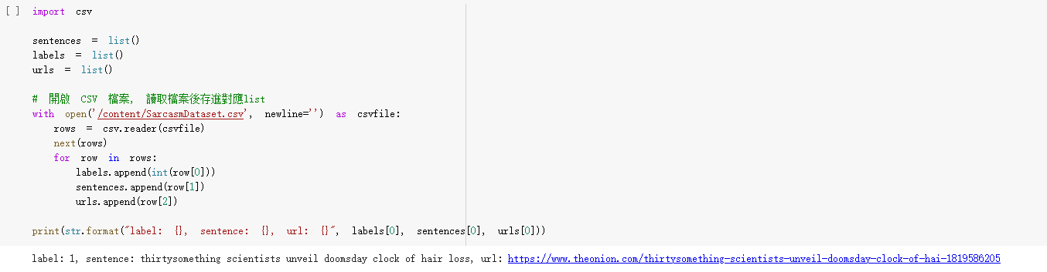
Load Data from CSV File
You can load the data from CSV file with these steps:

Slide 35
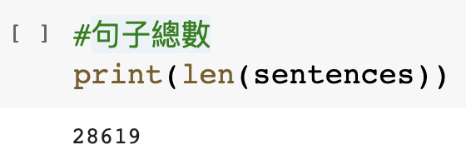
Amounts of Data
We can use len() to observer the size of data that intended to train.
Obviously, len() says we have 28619 data loaded from .json dataset.

Slide 36
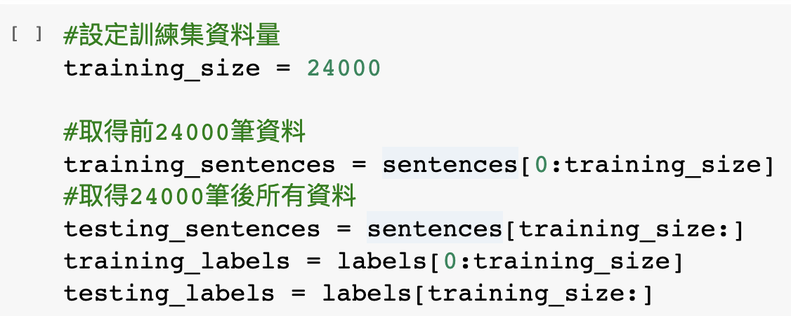
Split Dataset into Training and Testing
Since the dataset didn’t provide us the testing data, we should split it from origin dataset ourself.
We choose 24000 data for training and 4619 for testing.

Slide 37
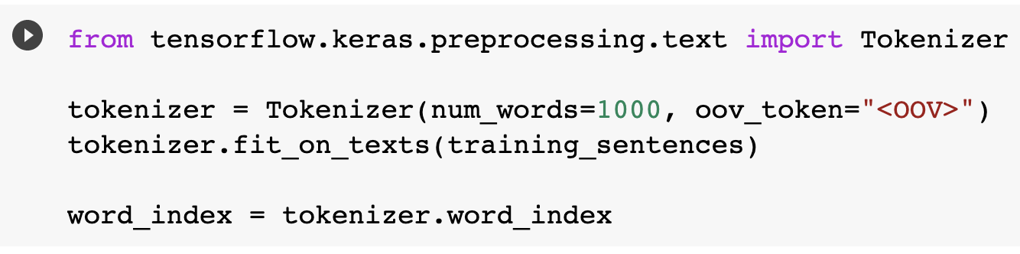
Tokenizing the Data
We should transfer our data from NLP to word index before training.
We can use fit_on_texts() to transfer it easily.

Slide 38
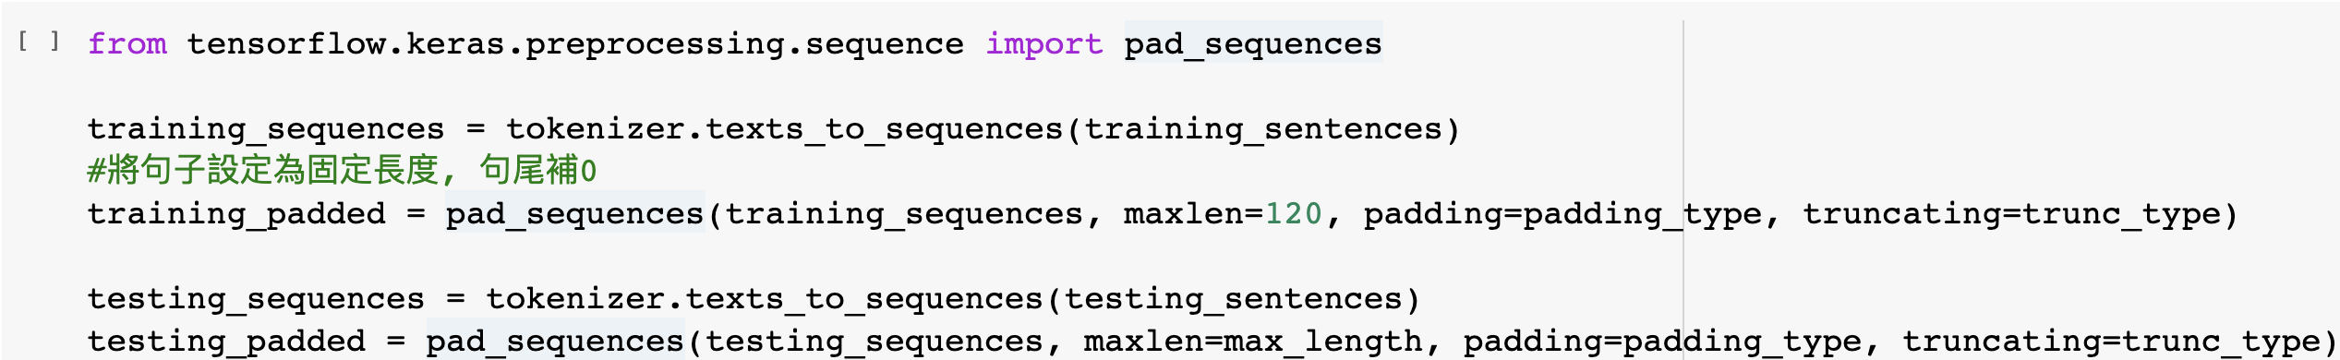
Pad Sequences
We should do pad sequences after tokenization.
The main idea is make sure all data have same length.
Keras provides a simple method pad_sqeuences() to do that.
1 2 3 4 5 6
1 3 4 0 0 0
2 5 0 0 0 0

Slide 39
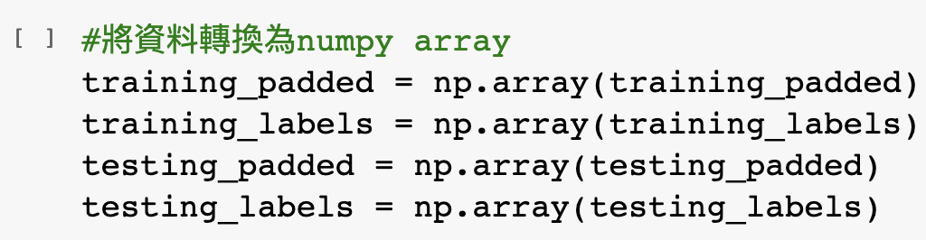
Turn the Data into Numpy Array
There’s one thing we should do before training, transfer all data into Numpy array.
Since all parameters in Keras are Numpy array, we should transfer our data as well
Simple, just call np.array() to transfer your data.

Slide 40
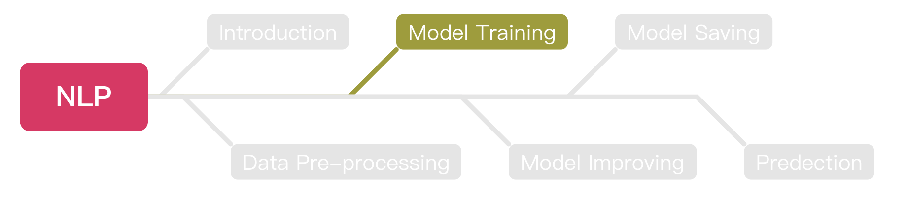
Outline

Slide 41
Embedding
At the beginning, each word has a sarcasm score 0.
The score will +1 if that sentence is labeled as sarcasm, -1 if not.
After thousands of rounds, we can get a final score of each word.
Calculate the total score of each sentence.
If the score > 0, we say this sentence is sarcasm.

Slide 42
Embedding (Cont’d)
There are two sentences “You love dog” and “How nice you are”.
We set “You love dog” as not sarcasm, “How nice you are” as sarcasm.
We know all words have 0 point at the beginning.
So, we can get the score of each word like below:
[you: 0, love: -1, dog: -1, how: 1, nice: 1, are: 1 ]
The score of ”you” will be like -1 + 1 = 0.
We can get the score of “How a nice person” as 1 + 0 + 1 + 0 = 2.
So we can say “How a nice person” is a sarcasm sentence.

Slide 43
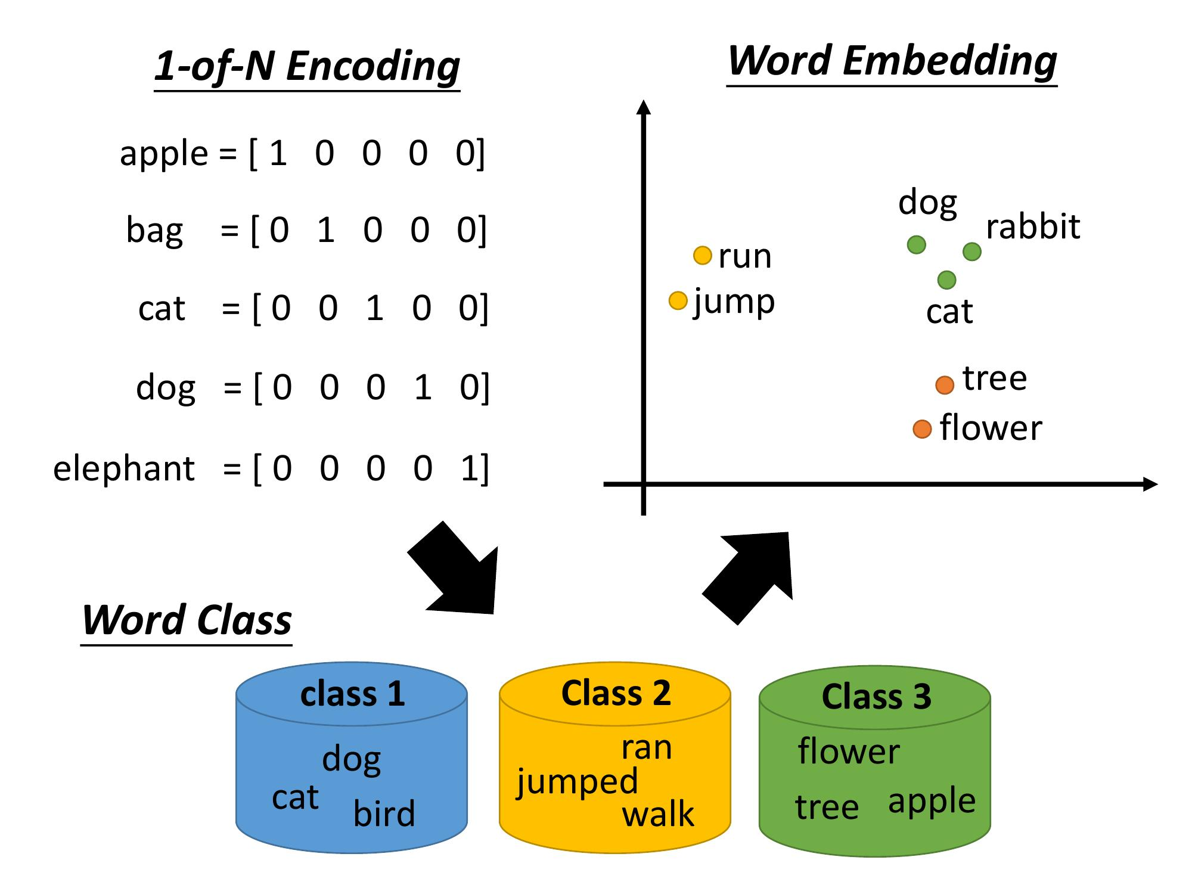


Embedding (Cont’d)
After embedding, we can get the vector of each word.
https://ai.ntu.edu.tw/resource/handouts/ML14.html
Notes:
Basically, the embedding result will be a multi-dimension vector.

Slide 44
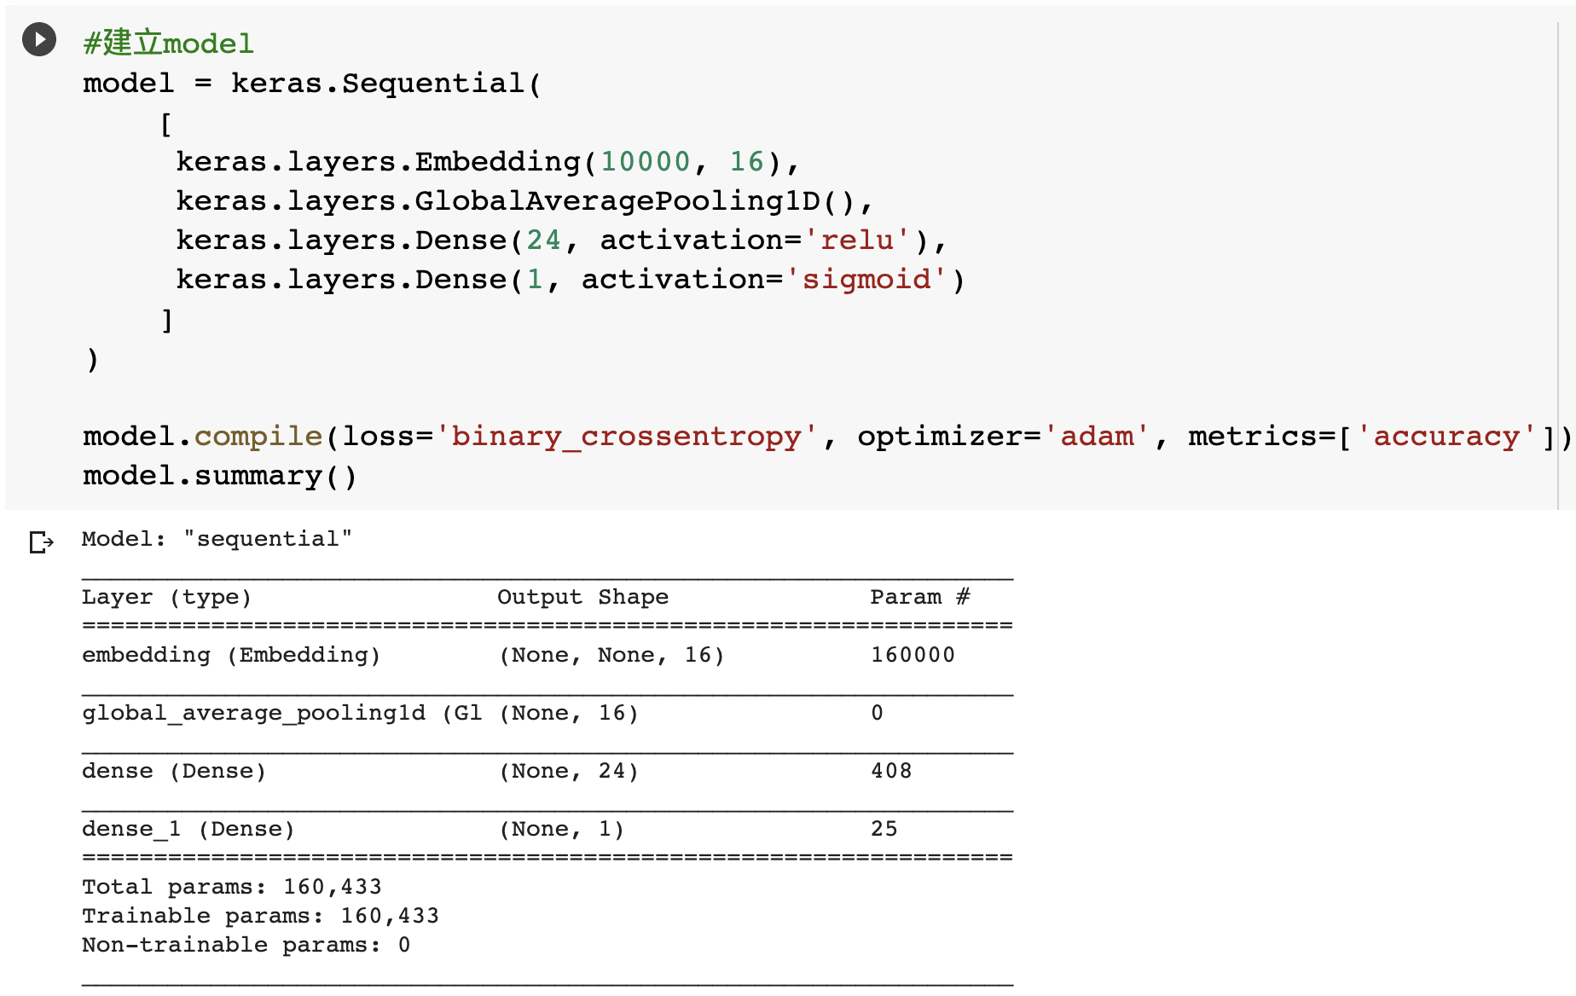
Building the Model
Notes:
The first layer is an embedding layer, which can accept 10000 words of input, and output a 1*16 flatten dense embedding result.
Then this vector will be input into a pooling layer, which will get the avg number and then output.
Next is a normal dense hidden layer, the activation function is relu.
Finally, a sigmoid output layer is attached.

Slide 45
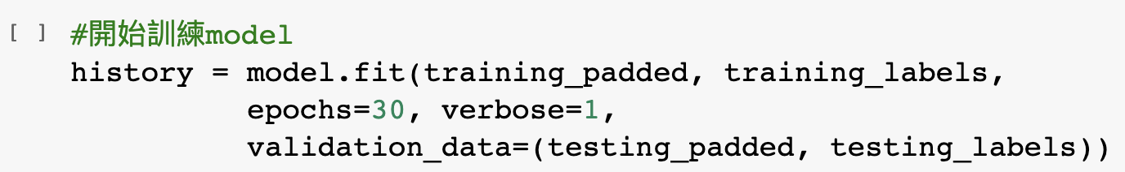
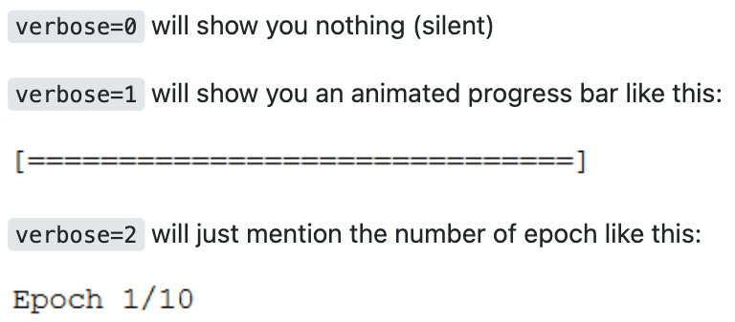
Training the Model
https://stackoverflow.com/questions/47902295/what-is-the-use-of-verbose-in-keras-while-validating-the-model
Notes:
There are three different showing modes during training, you can check the following image for detailed information.

Slide 46
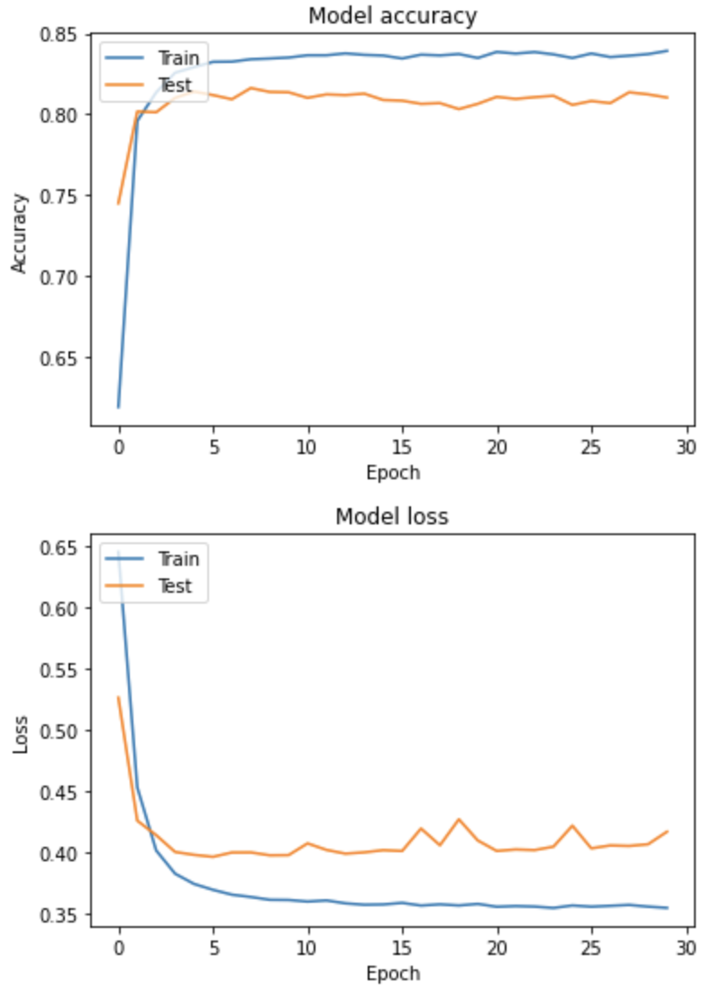
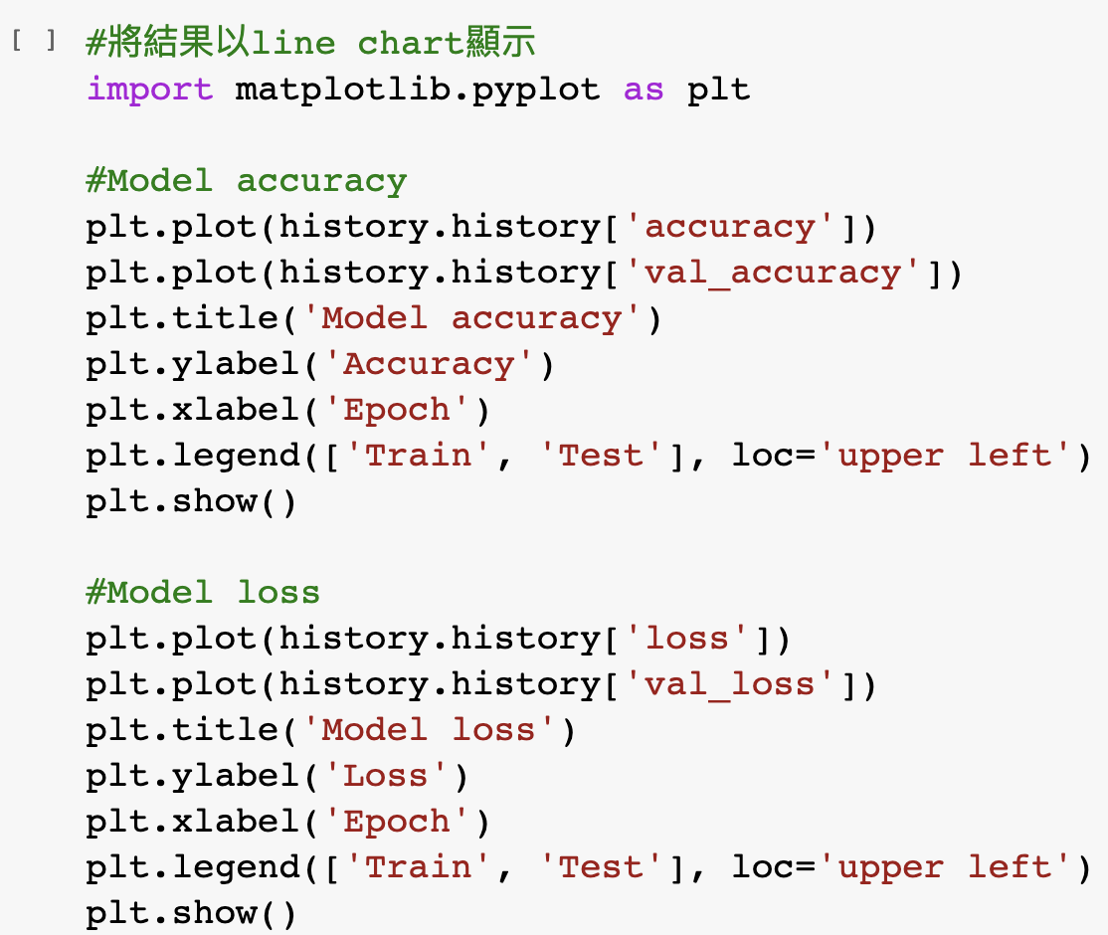
Plotting the Results
Notes:
The training results can be plotted with matplotlib. And the detailed information is provided last week.

Slide 47
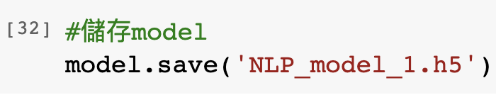
Saving the Model
We can save our trained model so that we don’t need to re-train it next time.
Notes:
After trained, we should save the trained model for future usages.

Slide 48
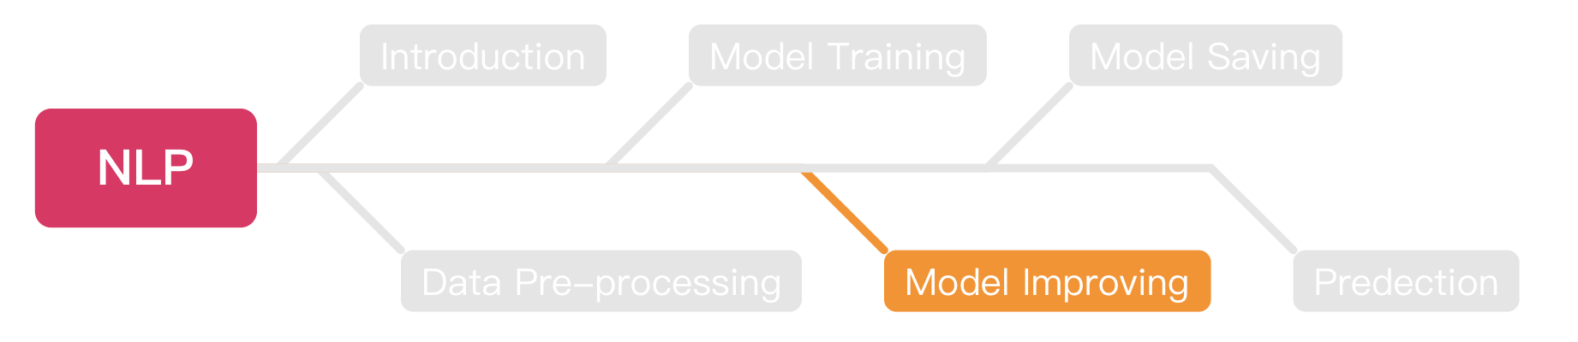
Outline

Slide 49
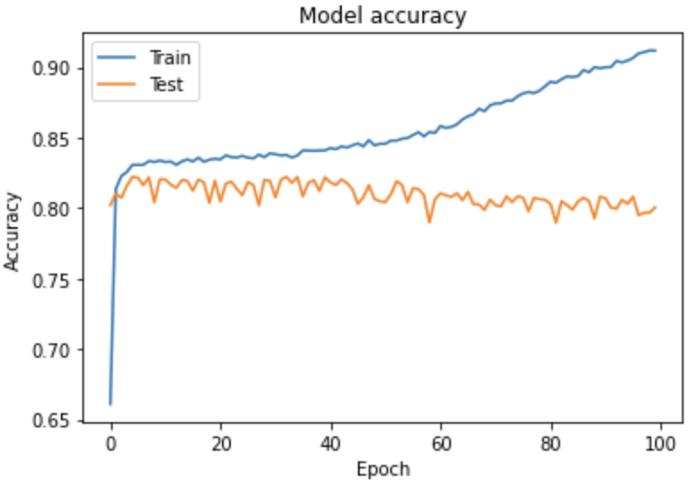
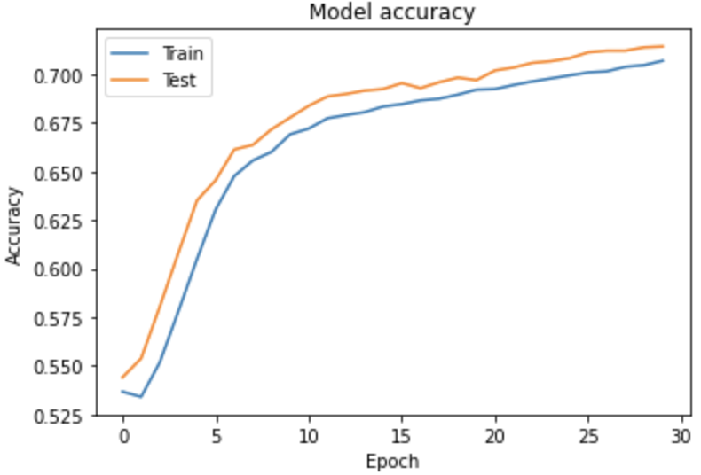
Before Model Improving
We should know these two different status before model improving.
Overfitting
Underfitting
Notes:
Before we start to improve, we should know the difference between overfitting and underfitting.
Overfitting means that this model is trained too much, and underfitting means not enough.

Slide 50
Overfitting
Overfitting is a problem that will happened during training your model.
The train accuracy gets higher but the validate accuracy remain the same or even lower.
Try to imagine if your model just memorize all the answers, how it will be if the question in test set has a little bit change?

Slide 51
Underfitting
Underfitting means your model can do better.
If you stop training when your model is growing, that will cause underfitting.
You should increase the epochs or the layer amounts to exploit the model to avoid underfitting.

Slide 52
Improving our model
After we know how to train our model, next step is to improve it.
We will try these ways to improve our model:
Increase the training epochs.
Add more hidden layers.
Use another NN for training.
Increase the amounts of data.
Improve the optimizer.

Slide 53
Improving Model
Increase the training epochs.
Add more hidden layers.
Use another NN for training.
Increase the amounts of data.
Improve the optimizer.

Slide 54
Building the Model

Slide 55
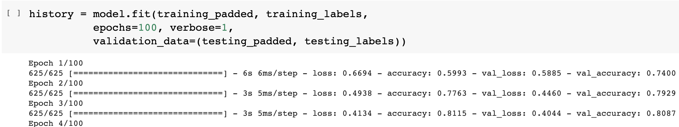
Improving the Epochs
The simplest way to try is improve the training epochs.
For example, increase from 30 to 100.

Slide 56
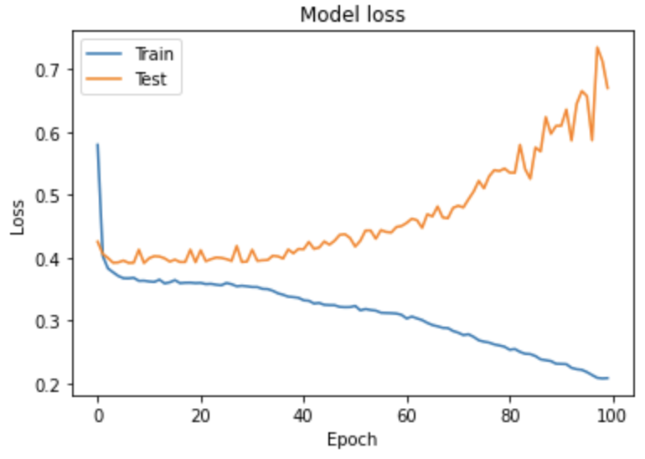
Plotting the Results

Slide 57
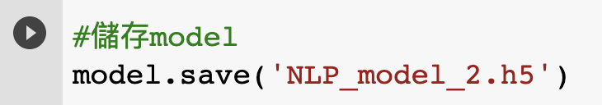
Saving the Model
We can save the trained model.

Slide 58

Next Steps
https://medium.com/initialized-capital/we-need-to-go-deeper-a-practical-guide-to-tensorflow-and-inception-50e66281804f
Notes:
Next step, go deeeeeeper.

Slide 59
Improving Model
Increase the training epochs.
Add more hidden layers.
Use another NN for training.
Increase the amounts of data.
Improve the optimizer.

Slide 60

Training with More Hidden Layers

Slide 61

Training with More Hidden Layers (Cont’d)
Train this model with 30 epochs.

Slide 62


Plotting the Result

Slide 63

Saving the Model
Save the trained model

Slide 64
Improving Model
Increase the training epochs.
Add more hidden layers.
Use another NN for training.
Increase the amounts of data.
Improve the optimizer.

Slide 65

RNN
RNN means recursively neural network.
RNN is one of the popular NN models, the characteristic is RNN will re-train the model with new data.
https://www.researchgate.net/figure/The-standard-RNN-and-unfolded-RNN_fig1_318332317
Notes:
The most common NN for NLP is RNN, which will use the trained weight and new input data to re-train the whole model.
Google search using RNN to predict the user input.

Slide 66

Long Short Term Memory
LSTM is the most popular implementation of RNN.
The simple way to understand LSTM is:
It will re-train the data with new data.
It will dropout the data that is not important.
It has a gate to determine if the data can be output to next layer.
https://www.rs-online.com/designspark/lstm-cn
Notes:
LSTM is the most popular implementation of RNN.
Some of the weights will be forgotten during training to avoid overfitting.

Slide 67

Training Model with LSTM
We can use the build-in LSTM layer of Keras to train our model.

Slide 68

Training Model with LSTM
Train the model with 30 epochs

Slide 69



Plotting the Results

Slide 70

Saving the Model

Slide 71
Improving Model
Increase the training epochs.
Add more hidden layers.
Use another NN for training.
Increase the amounts of data.
Improve the optimizer.

Slide 72
Training with More data
Since the data we have is not enough.
We should standing on the shoulders of giants.
Let’s use GloVe to train our model.
GloVe collects more than 2 billion tweets on Twitter.
The dataset more than 1.4 GB!

Slide 73

Downloading GloVe Dataset
We can download the dataset with a simple Linux command.
Or, you can download it via this link.
https://huggingface.co/stanfordnlp/glove/resolve/main/glove.twitter.27B.zip

Slide 74

Unzipping the Dataset
Python zipfile package can help you to zip or unzip files.
Always remember to close file stream after your works done.

Slide 75

Loading the Data
Now, let’s try to load the data from the dataset.
We choose to use glove.twitter.27B.25d.txt this file.
It means it has 27 billion of tokens and each token has 25 dimensions.

Slide 76

Try to Print the Coefficients
After we loaded the data, we can try to print the coefficients.

Slide 77

Filter the Data
Since this dataset is too large, it will take lots of time for training.
We just take what we need.

Slide 78

Preparing the Model

Slide 79

Training the Model
Train the model with 30 epochs.

Slide 80



Plotting the Results

Slide 81

Saving the Model

Slide 82
Improving Model
Increase the training epochs.
Add more hidden layers.
Use another NN for training.
Increase the amounts of data.
Improve the optimizer.

Slide 83

Optimizer
Don’t worry, we still the last skill.
Modify the optimizer.
https://zhenglungwu.medium.com/pytorch-optimizers-03-adam-adamax-f8f53429dc1d
Notes:
Adam is the most common optimizer for small DL model training since its low training epoch requirement.

Slide 84

Optimizer (Cont’d)

Slide 85

Optimizer (Cont’d)
https://blog.paperspace.com/intro-to-optimization-momentum-rmsprop-adam/

Slide 86

Learning Rate
We can see that if we should have optimal learning rate.
It means we can’t let our model learn too fast or too low.
https://ithelp.ithome.com.tw/m/articles/10204032
Notes:
Changing the learning rate might help us to achieve the minimum loss swiftly.

Slide 87

Results of 30 Epochs
Seems we got underfitting results.

Slide 88


Results of 50 Epochs

Slide 89


Results of 70 Epochs

Slide 90

Train the Model
Seems 50 epochs is the best solution.
Please try to train this model with 50 epochs.

Slide 91



Plotting the Results.

Slide 92

Saving the Model

Slide 93

Outline

Slide 94


Save the Model
You can save your trained model for next time prediction with these steps.
And download your model from colab with this script.

Slide 95

Outline

Slide 96

Loading Saved Model to Predict
You can load the local model with simple steps:
After loaded, this model can be used to do prediction.

Slide 97


Pre-processing
We should do the same steps to the data we intended to predict as the training data.
Just do that quickly.
Notes:
test_sequences = [
"Today is a sunny day",
"It was, For, Uh, Medcial Reasons, Says Doctor To Boris Johnson, Explaining Why They Had To Give Hime Hairvut",
"Pokémon Go player stabbed, keeps playing",
"thirtysomething scientists unveil doomsday clock of hair loss"]

Slide 98
Pre-processing (Cont’d)
Keep doing the pre-processing of our data.

Slide 99

Prediction
You can do the prediction with:
You can try to load other models we saved to see the results.

Slide 100

Exercise
We prepare two datasets for you to train your own model, both are stored as .csv file.
Of course, you can do the exactly same this with us to build a workable model, but I pretty sure it will be fascinating if you build your own one with difference method.
Link to datasets: https://drive.google.com/drive/folders/1kwORuSfpuPlqKKLFc3rhT0nHusqA6EzF?usp=sharing

Slide 101

Downloading the Notebook
You can download what you done in colab as .ipynb file.

Slide 102
Sending Your Works
Please download the works you done during the course as .ipynb file.
After finished the exercise, please also download it as .ipynb file.
Please send your works and exercise files to the mail: t109368093@ntut.org.tw

Slide 103
Thanks.

